Slide 1
The Scientific Method
Take notes in your workbook

Slide 2
What is Science?
Science is an organized way of using evidence to learn about the natural world.
The three goals of science are:
To investigate and understand the natural world
To explain events in the natural world
To use those explanations to make useful predictions

Slide 3
What type of science is Biology?
-OLOGY means the study of
“Bio” means life
Biology means… (drum roll, please)
THE STUDY OF LIFE
Therefore, Biology is the science that seeks to understand the living world.

Slide 4
Characteristics of Living Things
Living things are made up of units called cells.
Living things reproduce.
Living things are based on a universal genetic code.
Living things grow and develop.

Slide 5
Characteristics of Living Things
Living things obtain and use materials and energy.
Living things respond to their environment.
Living things maintain a stable internal environment (homeostasis)
Taken as a group, living things change over time.

Slide 6
Branches of Biology
Some of the levels at which life can be studied include molecules, cells, organisms, populations of a single kind of organism, communities of different organisms in an area and the biosphere. At all these levels, smaller living systems are found within larger systems.

Slide 7
Scientific Method Activity #1
As humans, we have a desire to understand the world around us. We naturally use the scientific method as we grow and learn.
A baby sees an object in front of him. He is curious about it. He puts it into his mouth. It tastes sour. He decides he does not like it and does not do it again.
Your group will be given cards to organize. Put them in a logical order and then write a sentence or two to justify why you put it in order.

Slide 8
Proper Order:
F: Tommy’s car won’t start.
This is an observation.
B: Tommy wonders why the car won’t start.
This is the question that Tommy wants answered.
D: Tommy thinks that his battery might be dead. “If the radio won’t turn on, then it must be the battery because the radio runs off of the battery.”
This is Tommy’s prediction or hypothesis of what will happen when he does his test.

Slide 9
Proper Order:
A: Tommy checks his radio.
This is the experiment itself.
G: The radio did not turn on.
This is the data. It is simply the observation of what happened.
E: The battery is dead.
This is the data analysis, it puts words or context to the data.
C: Tommy changes his battery.
This is the conclusion.

Slide 10
Scientific Method Notes: STEP 1: OBSERVATION​
Observe the natural world​
What do you see?​
What can you question?​
What don’t you understand about what you see?​
Learn to question things… that’s where science begins!!!
Note: The initial observation is generally not a part of your lab report.

Slide 11
Observations: Qualitative & Quantitative
We all share a desire to explore and understand the world around us. Science developed out of this curiosity. There are two basic types of observations – qualitative and quantitative.
Qualitative observations describe while quantitative observations measure.

Slide 12
Qualitative Observations:
Sense of Touch: Describe what you feel (It’s furry, smooth, rough, hard, soft).
Sense of Hearing: Describe what you hear (It crinkles, it squeaks).
Sense of Smell: Describe what you smell (It smells chemical, sweet, floral).
Sense of Sight: Describe what you see (Its color is..., it’s shiny, dull, see-through).
Sense of Taste: Describe what you taste (It’s sweet, sour, salty)

Slide 13
Small Group Discussion:
Which of your five senses would you least like to live without? Why?
Does your sense of smell enhance the experience of eating? Explain.
Do you think that you would enjoy your favorite food as much if you were unable to see it? Why or why not?

Slide 14
Quantitative Observations: (we use the metric system)
These are observations that can be measured.
Length - distance between two points
Meters or m
Mass - the amount of matter in an object
Grams or g
Volume - the amount of space the object takes up
Liters or L (we use a capital letter here so it isn’t confused with the number 1)

Slide 15
The Metric System
The metric system is based on tens. This makes it easy to convert because when you multiply or divide by ten, you only move the decimal point. Prefixes in the metric system tell us how much to multiply or divide by ten. The prefix is then followed by the type of measurement (meters, grams or liters).

Slide 16
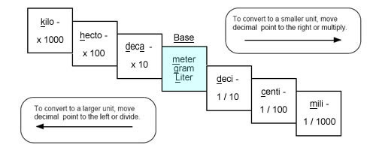
The Metric System
kilo (k)= x 1000
hecto (h)= x 100
deka (da)= x 10
(no prefix) = x 1
deci (d)= x 0.1
centi (c)= x 0.01
milli (m)= x 0.001

Slide 17
Metric conversion practice:
Let’s do a couple of examples of conversion.
Convert 178,000g to kg.
178kg - it takes 3 jumps to move the decimal from 1,000 to 1. so you move the decimal 3 places.
Convert 4L to mL, rounding to the nearest ones place.
4,000mL - there are three jumps to move the decimal from 0.001 to 1. so you move the decimal 3 places.
In your workbook, do the conversion practice on your own.

Slide 18
Day 2

Slide 19
Check your answers! (remember: don’t leave numbers naked)
60 mm
5,800 cg
1,000 mL
783,000 cm
40,000 mg
570,000 cL
80,000 m
8,000 cg
3,200 mL
1,000 cm
9 hg
19 daL
8.2 m
3 cg
2 kL
6.2 cm
0.24 g
3 cL
8.92 m
9.61 kg

Slide 20
Taking Measurements and Using Tools
What tool do we use to measure length?
Meter stick (ruler in cm)
What tool do we use to measure mass?
Triple beam balance (scale)
What tool do we use to measure volume?
For a regular object (ie: cube): meter stick length x width x height
For irregular objects or liquid: graduated cylinder

Slide 21
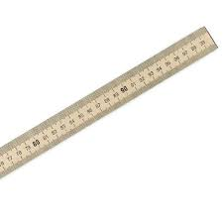
Meter Stick

Slide 22
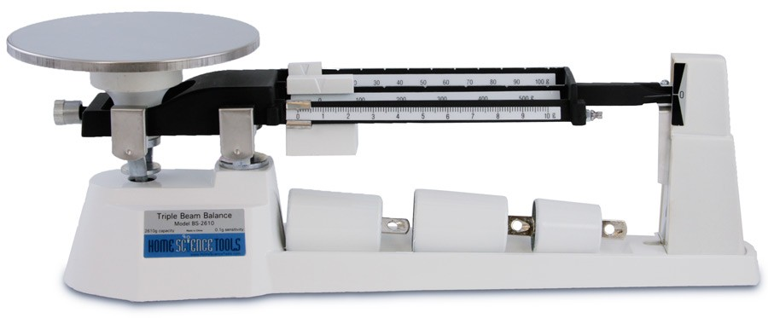
Triple Beam Balance

Slide 23
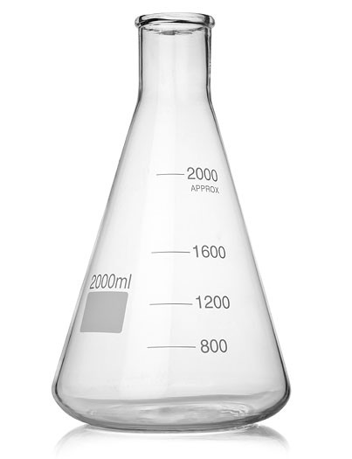
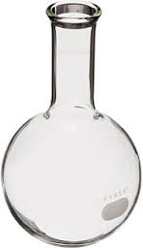
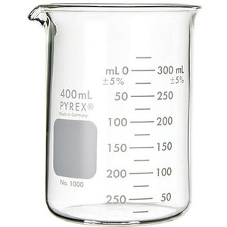
These can be used to mix liquids or heat them, but they are not for precise measurements
Beaker Erlenmeyer Flask Florence Flask

Slide 24
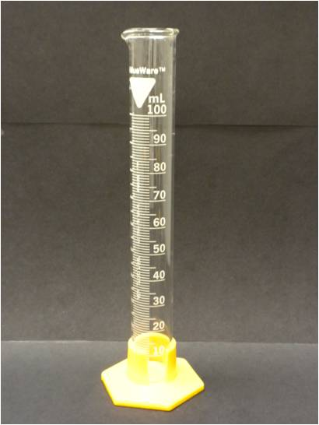
Graduated Cylinder
He’s the expert on
measuring liquids!!

Slide 25
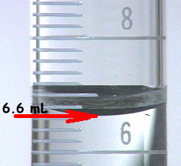
Proper reading of graduated cylinder:
Place graduated cylinder on a flat surface
Bend down to read it at eye level
Measure liquid from bottom of meniscus
* Meniscus: the curved upper surface
of a liquid in a tube

Slide 26
Lab Safety
All students should be able to work in safe laboratories. Permission to work in the science laboratory is a privilege. All students are financially responsible for lost or damaged equipment due to negligent or irresponsible behavior or failure to follow directions.

Slide 27
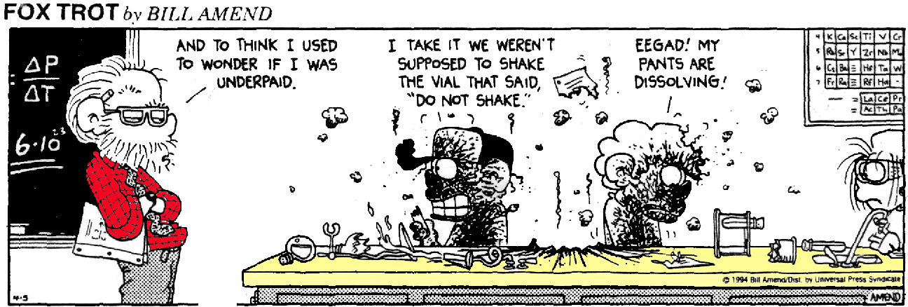
Lab Safety
1. Never perform unauthorized experiments or use any equipment or instruments without proper instruction. Follow all instructions given by the instructor including special direction for all individual experiments.

Slide 28
Lab Safety
2. Do not enter the stock/supply rooms. Do not work in the lab unless the instructor is present and you have instructor permission.

Slide 29
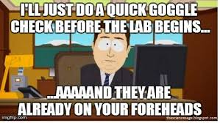
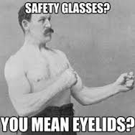
Lab Safety
3. Proper eye protection is to be worn when the potential for eye injury exists: spilling or splashing of hot or hazardous chemicals, for example. All spills must brought to the attention of the instructor and be cleaned up appropriately.

Slide 30
Lab Safety
4. Proper clothing is to be worn to protect against burns and/or chemical spill. No open shoes, sleeves below elbows or dangling jewelry are allowed in the laboratory. Long hair is to be tied back or confined.

Slide 31
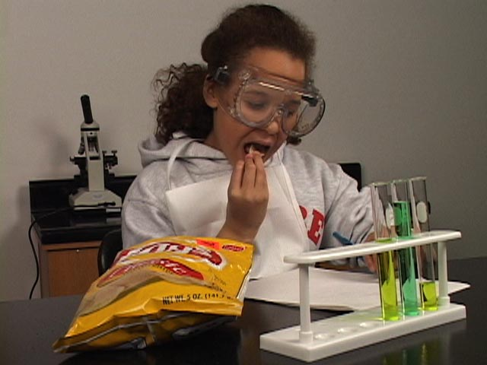
Lab Safety
5. Do not eat or drink anything in the lab at any time. Do not use any lab containers for food or drink. This includes chewing gum. Wash hands thoroughly after each lab.

Slide 32
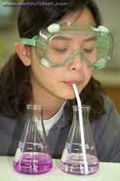
Lab Safety
6. Consider every chemical dangerous. Avoid inhaling fumes, pipetting by mouth, or tasting, touching or smelling any chemical unless specifically told to do so by the instructor.

Slide 33
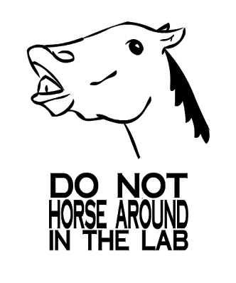
Lab Safety
7. Never become involved in horseplay or practical jokes.

Slide 34
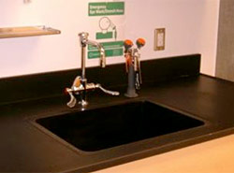
Lab Safety
8. Discard only those liquids or solids in the sink as indicated by the instructor.

Slide 35
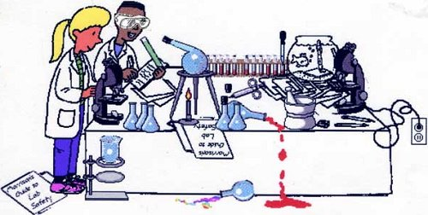
Lab Safety
9. Keep all non-laboratory materials away from lab stations.

Slide 36
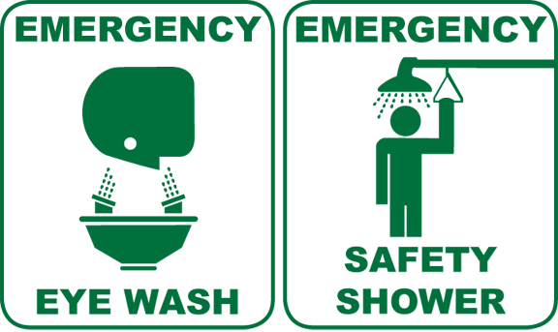
Lab Safety
10. Note the location and be familiar with the operation of any safety equipment. Do not use except in the case of an emergency.

Slide 37
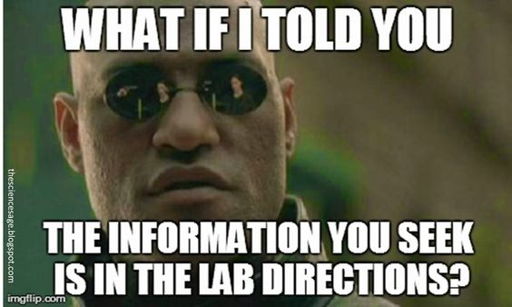
Lab Safety
11. Always listen to your instructor and notify her in the event of an accident! Because each lab can be unique, there may be additional rules or procedures that may not be listed here. It is your responsibility to pay attention and follow the directions.

Slide 38
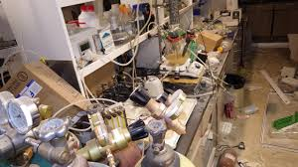
Lab Safety
12. Take proper care in cleaning the lab station before leaving.

Slide 39
Day 3

Slide 40
Measurement Lab

Slide 41
Day 4

Slide 42
Now we can start to make some observations:
On the following slide, there is a picture. In your workbook, write as many descriptive observations as you can.
Are there any qualitative observations?
Are there any quantitative observations?
Be ready to share with the class.

Slide 43
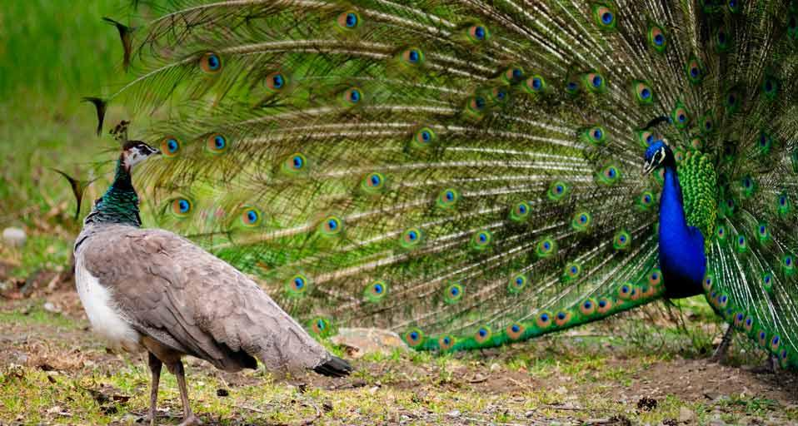

Slide 44
Scientific Method Notes: STEP 2: PROBLEM​
Usually written in the form of a question​
Your problem must be TESTABLE!​
The problem is the question you want answered by doing an experiment!

Slide 45
Now let’s come up with some questions (or a problem):
In your workbook, jot down a few questions that you may have regarding what you saw in the picture. Remember, these need to be questions that can be answered through testing.
Be ready to share yours with class, along with how you might test your problem.

Slide 48
Problem:
Scientific writing:
Does the length of the peacock’s feathers affect fertility rates?
In non-scientific terms:
Does a peahen dig long feathers on her man?

Slide 49
Scientific Method Notes: STEP 3: RESEARCH
Research allows you to find out some background information that might be necessary for designing your experiment.​
You may want to look up past experiments that have been done.​
Research is used to support your hypothesis!!!​

Slide 50
An important note on plagiarism
Plagiarism is “the practice of taking someone else's work or ideas and passing them off as one's own.” OxfordDictionaries.com
Plagiarism is not acceptable in writing for your other classes and it is certainly not acceptable in science either. Scientists and authors deserve recognition for their hard work and ideas.
It is also important in class to show that you have an understanding of what you have researched. If you can’t put it into your own words, you haven’t owned the material yet.

Slide 51
Is this plagiarism?
The peacock tail contains spectacular beauty because of the large feathers, bright, iridescent colours and intricate patterns. The colours in the tail feathers are produced by an optical effect called thin-film interference. The eye pattern has a high degree of brightness and precision because the colour-producing mechanisms contain an extremely high level of optimum design.

Slide 52
YES!!! It is identical to the excerpt

Slide 53
Is this plagiarism?
The peacock tail has great beauty because of the large feathers. The different colors in the tail feathers are produced by an effect. The pattern is bright because the color-producing mechanisms have a high level of design.

Slide 54
YES!!! It isn’t identical to the source but simply changing verbs and taking out or adding adjectives does not make it your work.

Slide 55
Is this plagiarism?
Peacocks have very sophisticated tail feathers. The designs and color on it are meant to have a high degree of specialization that cause an optical effect.

Slide 56
Not in words, but the idea is from Prof. Stuart Burgess and it is important that his work is cited.

Slide 57
How to prevent plagiarism:
Make sure that you cite your work.
Read many sources. The more you read, the more you will understand. This will give you more information to draw from as you write.

Slide 58
How to prevent plagiarism:
Paraphrase. Paraphrasing is not changing a verb here or adding or subtracting an adjective there. It is putting it into your words. The best way to do this is to read the material, do something else for at least 20 minutes and then write what you remember. If you can’t remember it or you are having a hard time, you didn’t fully understand or “own” the information. Go back and try again.

Slide 59
Now, You Try!

Slide 60
Scientific Method Notes: STEP 4: HYPOTHESIS
A hypothesis is a possible or tentative explanation for a question or problem.
Hypotheses are based on prior knowledge or research.
The hypothesis is not an educated guess.
A properly written hypothesis has a dependent and an independent variable.

Slide 61
Controlled Experiments
Don’t forget, all experiments must be “controlled”
This means that everything remains the same except the one variable you are manipulating (the thing you are testing!)

Slide 62
Independent -vs- Dependent Variables
Independent variable (or IV): this is what is having an effect on something else (the dependent variable). This is the one that is manipulated.
Dependent variable (or DV): this is what may happen because of the independent variable (it “depends” on the IV). This is the one that is measured.

Slide 63
Examples:
The amount of air in a basketball determines how high it will bounce.
IV: amount of air in basketball
DV: height ball bounces
The activity of a lizard increases with warmer weather.
IV: air temperature
DV: activity level of lizards

Slide 64
Practice: Your Turn!!
The IV and DV are in no particular order; you must read the statement and think!

Slide 65
Day 5

Slide 66
Answers:
IV: the amount of sunlight DV: how tall the plant grows
IV: level of hormones DV: migration rate
IV: number of students DV: teacher’s attitude
IV: amount of sleep DV: score on test
IV: person’s gender DV: how fast they learn
IV: girl’s shirt length DV: how often they raise hands
IV: whether they eat broccoli DV: test scores
IV: treatment with herbicide DV: number of weeds

Slide 67
Answers:
IV: amount of rainfall DV: number of flowers produced
IV: roughness of road DV: number of times falling
IV: years of experience DV: percentage of wins
IV: temperature DV: amount of food eaten
IV: chocolate eaten DV: number of pimples
IV: amount of light DV: rate of kelp growth
IV: color of the rock DV: amount of heat gained

Slide 68
Scientific Method Notes: STEP 4: HYPOTHESIS
Written in the form of “If…Then… Because…”​
If… = Experimental setup​ (includes Independent Variable)
Then… = What you think will happen​ (includes Dependent Variable)
Because… = Why will it happen (research)​
NO Personal Pronouns!!!​

Slide 69
Hypothesis Puzzle Activity

Slide 70
Day 6

Slide 71
How does salinity affect brine shrimp hatch rate?
If brine shrimp cysts are put into water with varying amounts of salinity (0%, 3%, 6%, 9%), then the brine shrimp cysts in the 3% salinity will hatch the greatest number of brine shrimp because brine shrimp are found in 3% salinity in the wild.
Independent variable?
% Salinity
Dependent variable?
Number of hatched cysts

Slide 72
How does sleep affect test scores?
If 4 groups of students are allowed different amounts of sleep per night (5 hours, 7 hours, 9 hours, 11 hours), then the group that gets 9 hours of sleep per night will have the highest test scores because 9 hours of sleep allows enough rest while staying within a natural rhythm.
Independent variable?
Number of hours of sleep
Dependent variable?
Test scores

Slide 73
Your Turn:
Scenario: Your mom has a bunch of potted petunia plants on the patio. You notice that some of them are a lot taller than others.
What is a possible problem?
What is the IV and DV for your problem?
Be ready to share yours with the class.

Slide 74
What’s wrong with these hypotheses?
If 4 plants are given different amounts of fertilizer, then the most fertilizer will grow the best.
Fertilizer doesn’t grow
What does “best” mean? How can we measure it? Use a better word like “tallest” or “fastest”.
Where’s the “because” part of the statement?

Slide 75
What’s wrong with these hypotheses?
If a plant is placed in the dark and another in the light, then the light will photosynthesize more because light is required for photosynthesis.
Is the light photosynthesizing?
The word “more” is used… more than what? You need a comparison, something measureable.

Slide 76
What’s wrong with these hypotheses?
If a lion is scared of a human, then it will run.
What’s it?
Where’s the because?

Slide 77
More Practice:
John noticed that his dog would get excited and go to the front door before his father would even open the door. He wondered whether his dog predicted his father’s return home by knowing the sound of his father’s car as it pulled into the driveway.
What is the problem?

Slide 78
More Practice:
Does Rover recognize the sound of Dad’s car?
What would a good hypothesis be?
If Rover hears four different cars pull up into the driveway, then he will only go to the front door when Dad’s car pulls into the driveway because dogs can be conditioned to recognize different sounds.

Slide 79
Let’s go back to our peacock….
Problem: Does the length of the peacock’s feathers affect fertility rates?
Hypothesis: If a peacock’s feathers are clipped, then he will get less attention from the peahens because long feathers on a peacock’s tail is linked to health and fertility.

Slide 80
Day 7

Slide 81
Problem and Hypothesis problems:
1.Sally wants to test whether the amount of soil put into each pot will affect the growth of the plants. She wants to compare 2 cups of soil, 4 cups of soil, 6 cups of soil or 8 cups of soil.
What is the problem?
Does the amount of soil a plant grows in affect the plant’s growth?

Slide 82
Problem and Hypothesis problems:
Independent variable? Amount of soil
Dependent variable? Height or growth of plant
Hypothesis: If plants are grown in different amounts of soil (2 cups, 4 cups, 6 cups or 8 cups), then the plant in the 8 cups of soil will grow the tallest because the size of a plant’s root system determines the height in which it can grow.

Slide 83
Problem and Hypothesis problems:
2. Bobby notices that plants grow taller in different areas of his backyard. He wonders if the amount of sunlight each plant is getting on a daily basis affects how fast it grows. He wants to compare 3 hours of sunlight, 6 hours of sunlight, 9 hours of sunlight and 12 hours of sunlight.
What is the problem?
Does the amount of exposure to sunlight affect plant growth?

Slide 84
Problem and Hypothesis problems:
Independent variable? Amount of sunlight
Dependent variable? Height or growth of the plant
Hypothesis: If plants are exposed to various amounts of sunlight (3 hours, 6 hours, 9 hours or 12 hours), then the plants exposed to 12 hours of light will grow the tallest because plants need light to create food used for growth.

Slide 85
Problem and Hypothesis problems:
Jen has many rose bushes in her backyard. She notices that some rose bushes seem to be growing faster than others. She realizes that the rose bushes are all planted in different size pots. She wants to compare a 6 inch pot, a 12 inch pot, an 18 inch pot and a 24 inch pot.
What is the problem?
Does the size of the pot a plant is grown in affect it’s growth rate?

Slide 86
Problem and Hypothesis problems:
Independent variable? Size of the pot
Dependent variable? Growth rate of plant
Hypothesis: If plants are grown in different sized pots (6 inch, 12 inch, 18 inch or 24 inch), then the plant in the 24 inch pot will grow the fastest because when plant roots have more room, they are able to absorb more nutrients.

Slide 87
Problem and Hypothesis problems:
Sandy has been keeping a close eye on her garden lately. Recently, she noticed the presence of a few new types of bugs. She also noted that some of her plants were producing different amounts of fruit than they were before the bugs showed up. She wants to compare ladybugs, earthworms, bees and caterpillars.
What is the problem?
Do insects affect the amount of fruit a plant produces?

Slide 88
Problem and Hypothesis problems:
Independent variable? Type of insect
Dependent variable? Amount of fruit produced
Hypothesis: If plants are exposed to different types of insects (ladybugs, earthworms, bees or caterpillars), then the plants exposed to bees will produce the most fruit because bees pollinate the flowers of plants.

Slide 89
Problem and Hypothesis problems:
Paul noticed that some of the potted plants in his backyard were growing taller than others. He thought maybe this was due to the type of fertilizer the plants were given. He wants to compare Speedy Grow Fertilizer, Miracle Grow Fertilizer, Quick Grow Fertilizer and coffee grounds.
What is the problem?
Do some fertilizers allow plants to grow taller than others?

Slide 90
Problem and Hypothesis problems:
Independent variable? Fertilizers
Dependent variable? Height or growth of plant
Hypothesis: If plants are given different kinds of fertilizers (Speedy Grow Fertilizer, Miracle Grow Fertilizer, Quick Grow Fertilizer or coffee grounds), then the plant given Speedy Grow Fertilizer will grow the tallest because it has the highest amount of Nitrogen and Phosphorus which are both needed for plant growth.

Slide 91
Problem and Hypothesis problems:
Sam noticed that his cell phone battery died more quickly on some days. He wondered if the type of app he was using affected the amount of energy the phone used. He wants to compare youtube video streaming, his mp3 player, his Angry Birds game and his facebook app.
What is the problem?
Do some cell phone apps use more energy than others?

Slide 92
Problem and Hypothesis problems:
Independent variable? Cell phone apps
Dependent variable? Amount of energy used
Hypothesis: If various apps on a cell phone (youtube video streaming, mp3 player, Angry Birds game or facebook app) are on for an hour each, then the video streaming will use the most energy because the cell phone simultaneously runs the app and uses the Internet.

Slide 93
Scientific Method Notes: STEP 5: EXPERIMENT
The experiment is what you actually do. The experimental set-up itself is described in the materials and procedure portion of your lab report. You must be precise in your materials and procedures. Remember, someone from another country may want to reproduce your experiment - they don’t know our slang.

Slide 94
Scientific Method Notes: STEP 5: EXPERIMENT
It must be controlled - you are only testing one variable at a time.
You should have:
Multiple trials
Large number of individuals
It must relate to your problem (question).

Slide 95
Scientific Method Notes: MATERIALS
List everything you plan to use in the lab
This includes all equipment, along with any solids or liquids you are going to need.
Use a bulleted format!

Slide 96
Scientific Method Notes: MATERIALS
Proper bulleted format for materials:
Feather trimmers
6 10m x 10m wire enclosures
Premium cracked corn
Strawberries
Meter stick
Not: Feather trimmers, 6 10m x 10m wire enclosures, Premium cracked corn, Strawberries and a Meter stick

Slide 97
Scientific Method Notes: PROCEDURES
It is a step-by-step numbered list:
1.
2.
It needs to be specific and detailed - someone else has to be able to follow your exact experiment!
Remember: NO PERSONAL PRONOUNS!!

Slide 98
Procedures:
Obtain 12 male and 12 female peafowl of one year of age.
Have two males and two female peafowl per enclosure.
Match pairs of males according to size and coloring to minimize variation.
Of the pairs of males, choose one to have his feathers trimmed.
Using the feather trimmers, trim 30cm from the outermost feathers.

Slide 99
Day 8

Slide 100
Procedures Activity
You will be given a card with some shapes on it. On a separate piece of paper, write instructions on how to replicate the image in procedures format. You have 10 minutes to complete this.

Slide 101
Day 9

Slide 102
Scientific Method Notes: STEP 6: RESULTS/DATA
Record in tables
Organized
Neat
Use graphs and charts
Makes a visual representation of raw data

Slide 103
Data Table Requirements
Title
Neat and organized
Use a ruler if doing by hand
Headings for columns and rows
Be sure to include units when appropriate

Slide 104
Example:
Number of Times Peacocks in Each Enclosure Who Mated in 10 days
 | Pen 1 | Pen 2 | Pen 3 | Pen 4 | Pen 5 | Pen 6 | Pen 7 | Pen 8 | Pen 9 | Pen 10 | Pen 11 | Pen 12
Unaltered Males | 6 | 3 | 1 | 7 | 4 | 6 | 5 | 6 | 2 | 0 | 6 | 8
Trimmed Feathers Males | 0 | 0 | 0 | 2 | 0 | 1 | 1 | 0 | 0 | 0 | 1 | 2

Slide 105
Practicing Data Tables
Create a data table comparing the total calories, carbohydrates, protein, and fat of three cereals

Slide 106
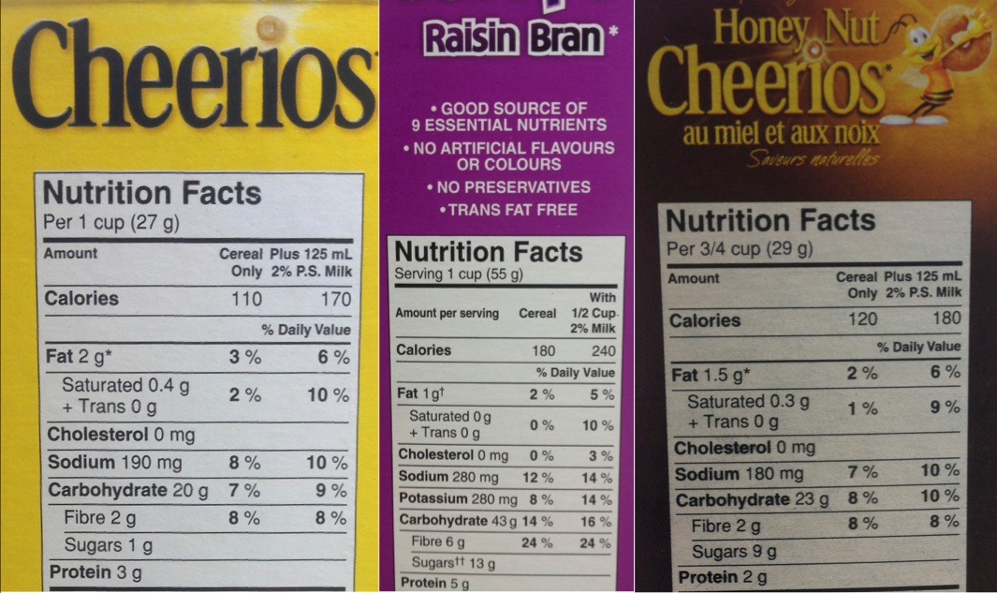

Slide 107
Nutritional Facts of Cereal
 | Calories | Fat (in grams) | Carbohydrates (in grams) | Protein (in grams)
Cheerios | 110 | 2 | 20 | 3
Raisin Bran | 180 | 1 | 43 | 5
Fruity Pebbles | 146.7 | 1.3 | 30.7 | 1.3

Slide 108
Graph Requirements
Title
Label both the x- and y-axis
Be sure to include units if necessary
Legend (if needed)
Color (and no… pencil is not a color)
Straight lines - Use a ruler to make ALL lines!!!
Use at least ¾ of your graph paper!

Slide 109
Graphing Examples: Pie Charts
Pie charts are used to compare parts of the whole or for percentages
Class grades from previous year
Male vs female
Number of students in each graduating class

Slide 110
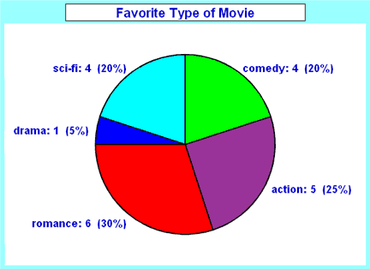

Slide 111
Graphing Examples: Bar Graphs
Bar graphs are used when you are dealing with an independent variable that is qualitative and you are just looking at a snapshot of time.
If you have multiple groupings within each independent variable, then you will have a multi-bar graph and need a legend or key.

Slide 113
Graphing Examples: Line Graphs
Line graphs are used when both the independent and dependent variables are quantitative or when data is taken over a period of time.
If you have multiple groups of measurements over a period of time, you will be using a line graph with multiple lines. For this, you will also have a legend or key.

Slide 114
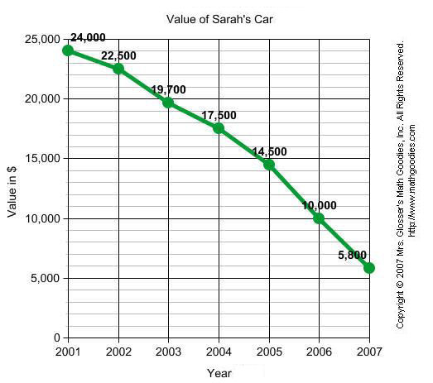

Slide 115
What type of graph would you use?
2nd Semester Biology Grades for 2016
 | A | B | C | D | F
Number of Students | 25 | 35 | 35 | 23 | 24

Slide 116
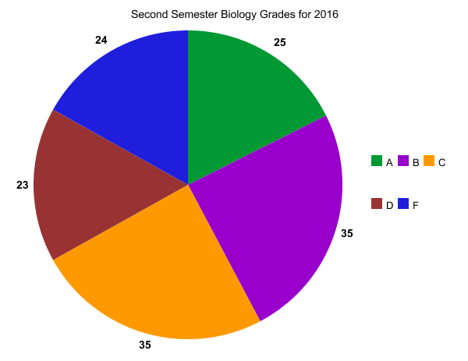

Slide 117
What type of graph would you use?
You plant 3 mesquite trees in the same type of soil. One plant will receive no fertilizer. The second plant will receive Miracle Grow fertilizer. The third plant will receive composted manure. You will measure the height of the trees after 2 years.
Two Year Height of Mesquite Trees in Fertilizer
 | No fertilizer | Miracle Grow | Composted Manure
Height (m) | 4.1 | 4.5 | 4.3

Slide 118
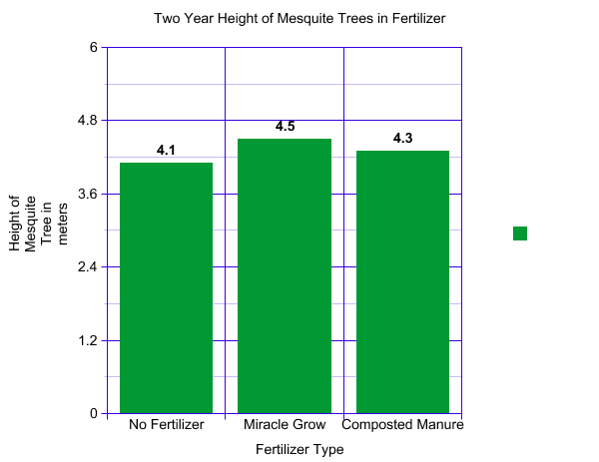

Slide 119
What type of graph would you use?
Number of students involved in Extracurricular Activities
 | Freshmen | Sophomore | Junior | Senior
Sports | 198 | 215 | 167 | 120
Clubs | 115 | 157 | 182 | 65
Performing Arts | 184 | 147 | 92 | 87

Slide 120
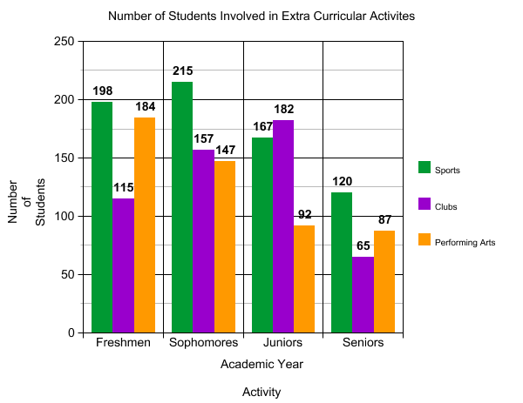

Slide 121
What type of graph would you use?
Growth of James in his First Year
 | June | July | Aug | Sept | Oct | Nov | Dec | Jan | Feb | Mar | Apr | May
Height (cm) | 49 | 54 | 57 | 60 | 62 | 64 | 66 | 67 | 69 | 70 | 71 | 73

Slide 122
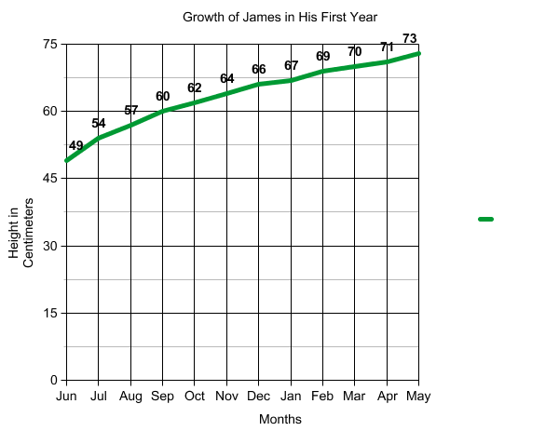

Slide 123
What type of graph would you use?
Growth of Mesquite in Fertilizer Over 24 Months (in meters)
 | 0 mo | 3 mo | 6 mo | 9 mo | 12 mo | 15 mo | 18 mo | 21 mo | 24 mo
No Fertilizer | 1 | 1.4 | 1.8 | 2.2 | 2.6 | 2.9 | 3.3 | 3.7 | 4.1
Miracle Grow | 1 | 1.5 | 1.9 | 2.4 | 2.8 | 3.2 | 3.5 | 4.0 | 4.5
Composted Manure | 1 | 1.4 | 1.9 | 2.3 | 2.7 | 3.1 | 3.4 | 3.8 | 4.3

Slide 124
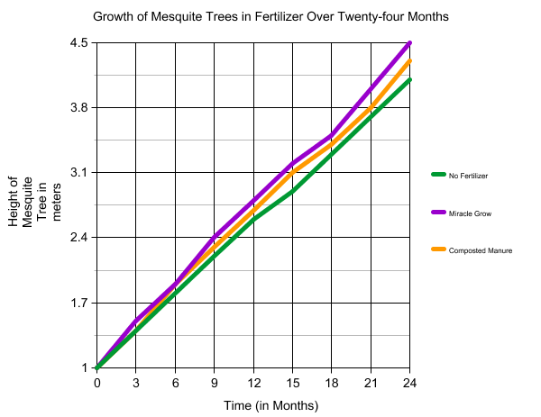

Slide 125
What type of graph would you use?
Climate of Vancouver, British Columbia
 | Jan | Feb | Mar | Apr | May | June | July | Aug | Sept | Oct | Nov | Dec
Temp (in ºC) | 2 | 4 | 6 | 9 | 13 | 15 | 18 | 17 | 14 | 10 | 6 | 4
Prec (in mm) | 146 | 125 | 99 | 58 | 48 | 50 | 26 | 37 | 57 | 121 | 148 | 153

Slide 126
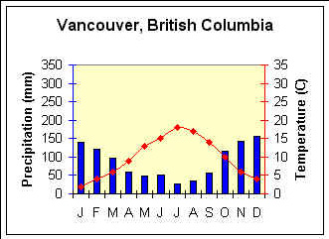

Slide 127
Now You Try!!! Create A Bar Graph (Use Your Rubric)
Number of Times Peacocks in Each Enclosure Who Mated in 10 days
 | Pen 1 | Pen 2 | Pen 3 | Pen 4 | Pen 5 | Pen 6 | Pen 7 | Pen 8 | Pen 9 | Pen 10 | Pen 11 | Pen 12
Unaltered Males | 6 | 3 | 1 | 7 | 4 | 6 | 5 | 6 | 2 | 0 | 6 | 8
Trimmed Feathers Males | 0 | 0 | 0 | 2 | 0 | 1 | 1 | 0 | 0 | 0 | 1 | 2

Slide 128
Now You Try!!! Create A Line Graph (Use Your Rubric)
Amount of Oxygen (in cm³) Produced by Plants in
Different Colors of Light
 | 0 hr | 3 hrs | 6 hrs | 9 hrs | 12 hrs | 15 hrs | 18 hrs | 21 hrs | 24 hrs
Red light | 0 | 0.2 | 0.5 | 0.9 | 1.4 | 1.9 | 2.5 | 3.2 | 3.8
Blue light | 0 | 0.3 | 0.6 | 1.1 | 1.6 | 2.2 | 2.8 | 3.5 | 4.1
Yellow light | 0 | 0.1 | 0.2 | 0.2 | 0.3 | 0.4 | 0.5 | 0.6 | 0.7
Green light | 0 | 0 | 0 | 0.1 | 0.1 | 0.2 | 0.2 | 0.2 | 0.3

Slide 129
Day 10

Slide 130
Rubric for Bar Graph
We will grade this TOGETHER!!
Correct type of graph _____/4 Appropriate Title _____/2
Legend _____/4 Color _____/2
Labeled the x-axis _____/3 Labeled the y-axis _____/3
Straight Lines _____/4 Used ¾ of paper _____/3
Information Accurate _____/10 Total: _____/35 points
Make sure to put your name on the line and the total grade on the front cover.

Slide 131
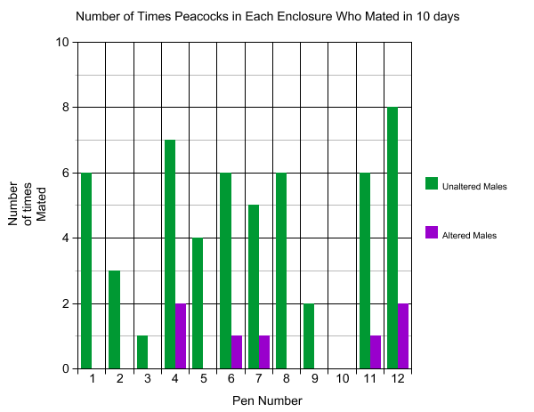

Slide 132
Rubric for Line Graph
We will grade this TOGETHER!!
Correct type of graph _____/4 Appropriate Title _____/2
Legend _____/4 Color _____/2
Labeled the x-axis _____/3 Labeled the y-axis _____/3
Straight Lines _____/4 Used ¾ of paper _____/3
Information Accurate _____/10 Total: _____/35 points
Make sure to put your name on the line and the total grade on the front cover.

Slide 133
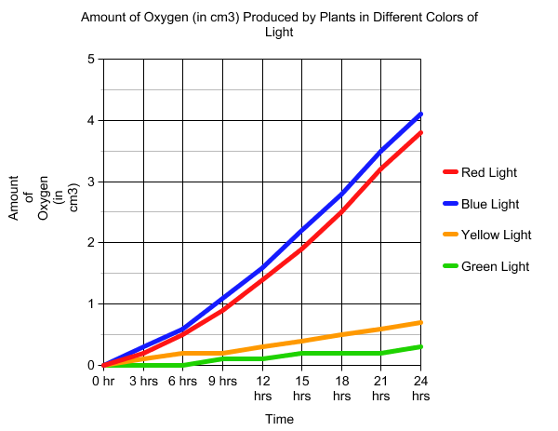

Slide 134
STEP 7: ANALYSIS
Write this section in paragraph form.
Relate your data/results back to your original hypothesis (did the data support or reject your hypothesis?) Be sure to explain why or why not.
There should be actual data being referred to in this section.
Any problems, errors, or unusual results should be mentioned here.

Slide 135
STEP 7: ANALYSIS
This is not a re-write of what was done in the lab, you already listed the procedure above.
It is also not a listing of the data but rather what is important (or possibly how there was nothing significant) about the data.
It is the analysis of the data collected and how it relates to the hypothesis as written.
Remember: No personal pronouns in lab write-ups!

Slide 136
Analysis Example
The plants that were exposed to the yellow light produced less than 1 cm3 of oxygen in a 24 hour period, whereas the plants exposed to the red or blue light produced more than 3 cm3 each. Therefore, the hypothesis was refuted. Possible errors include the plants under the yellow light being under a vent which may have lowered the temperature and the plant under the blue light being exposed to white light for 15 minutes during the 4th hour of the experiment.

Slide 137
STEP 8: CONCLUSION
This section is written in paragraph form.
In this section you will relate back to the original problem. Can you answer the question(s) you had at the beginning? You should find yourself explaining why or how.
Information obtained through the research will be your greatest assistance in “concluding” the lab write up. Do the results of your experiment match the information you found out through research? If they don’t match, why do you think that is?

Slide 138
STEP 8: CONCLUSION
If your results were inconclusive, you may need to carry out an additional experiment. If that is the case, you would describe a possible additional experiment that would result in more conclusive data.
Also, if you were given additional questions, you would answer them here.
Although you had so much fun doing your lab, it is not appropriate to mention that in the lab write-up.
Remember: No personal pronouns in lab write-ups!

Slide 139
Conclusion Example:
This experiment answered the question, “does the color of light plants are exposed to affect the rate of photosynthesis?” There were plants that yielded the most oxygen (and therefore the most photosynthesis took place). These plants were exposed to red or blue light. This is supported by Blackman’s experiments that green and yellow pigments reflect green and yellow light. Since red and blue light are not reflected, they are absorbed. For future experiments, exposing plants to a combination of red and green or blue and yellow may create different results.

Slide 140
Scientific Theory
Repeating experiments: a key assumption in science is that experimental results can be reproduced because nature behaves in a consistent manner. Scientists expect to test on another’s investigations.
As evidence from numerous investigations builds up, a particular hypothesis may become so well supported that scientists consider it a theory.
In conversation, people may say that they have a theory - this is usually a hypothesis. In science, the word theory applies to a well-tested explanation.

Slide 141
Are you ready for your own lab??????
Some ideas:
*Test reflexes
-sound versus sight
-touch: cold versus room temperature
-with or without music
*Test behavior of mealworms (you must obtain some materials)
*****All experiments must be approved!!!!!

