Slide 1
Cellular
Respiration

Slide 3
Cellular Respiration
Definition
The process by which glucose molecules are broken down to release energy is called cellular respiration.

Slide 5
Cellular Energy
All organisms need a source of energy (ATP).
Heterotrophs use the organic compounds in food for energy sources.
Before energy in complex carbohydrates can be used by cells, it must be broken down into simple sugars like glucose.
This breakdown of glucose is done by our digestive system.

Slide 7
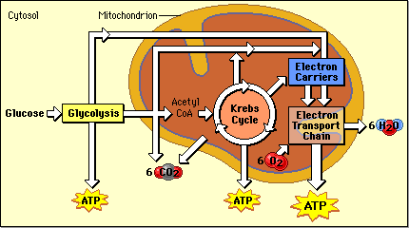

Slide 8
Three Stages of Cellular Respiration
Glycolysis
Glucose splits into two
Lysis = to burst or break
Takes place in the cytoplasm
Produces 2 ATP (energy molecules)
It actually makes 4 ATP, but it uses 2 ATP.
4 ATP -2 ATP = 2 ATP

Slide 9
Krebs Cycle
Also called the Citric Acid Cycle
Occurs in the Mitochondria
Requires Oxygen
The glucose, which was already split in two, is broken down further to make CO2.
- The CO2 is released into the atmosphere
Produces 2 ATP and high-energy electrons
- These electrons are carried by electron carriers (NADH and FADH2)

Slide 10
Electron Transport Chain
Occurs in the mitochondria
Requires oxygen
The high-energy electrons are passed down a chain of proteins
At the end of the chain, these electrons are combined with hydrogen and oxygen to form water.
This process makes 32 ATP from ADP

Slide 11
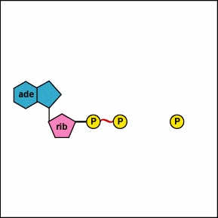
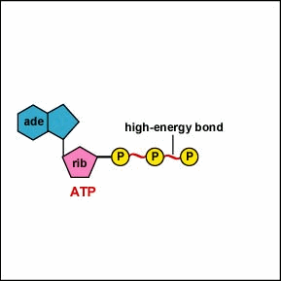
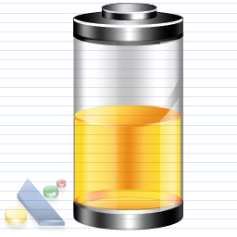
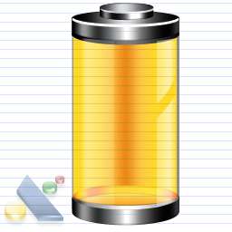
ADP → ATP
Energy Released

Slide 12
How are ADP and ATP different?
Adenosine
Di
Phosphate
Adenosine
Tri
Phosphate

Slide 13
In Mitochondria with oxygen present
In Cytoplasm
NADH and FADH₂
Glycolysis
Krebs Cycle
Electron Transport
2 ATP
2 ATP
32 ATP

Slide 14
Cellular Respiration
Anaerobic = without oxygen
Glycolysis
Aerobic = with oxygen
Krebs Cycle and Electron Transport Chain

Slide 15
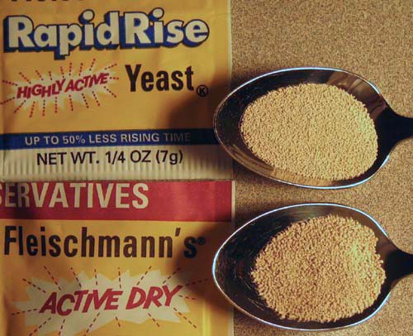
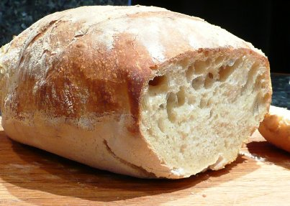
Alcoholic Fermentation
Yeasts (single-celled fungi) and a few other microorganisms use alcoholic fermentation
Forms ethyl alcohol and CO₂ as wastes
Glycolysis → CO₂ + alcohol + 2ATP

Slide 16
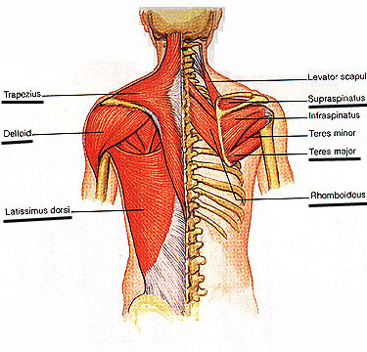
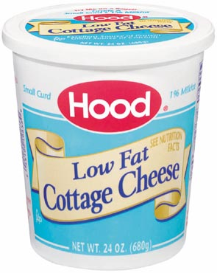
Lactic Acid Fermentation
Lactic acid is produced in your muscles during rapid exercise when the body cannot supply enough oxygen to the tissues
Without enough oxygen, the body isn’t able to produce all the ATP that is required
Glycolysis → lactic acid + CO₂ + 2ATP
- Lactic acid can also be found in sour milk products like yogurt and some cottage cheeses!

Slide 17
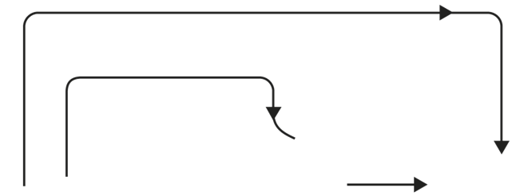
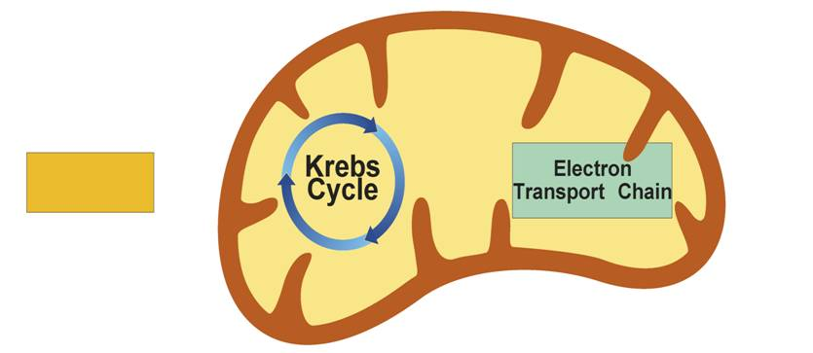
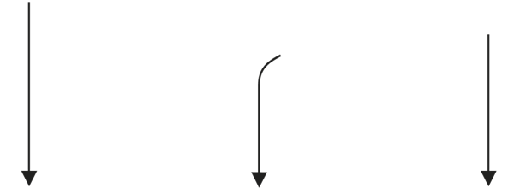
Electrons carried in NADH
Electrons carried
in NADH and
FADH₂
Pyruvic acid
Glucose
Glycolysis
Cytoplasm
Mitochondrion
2
2
32
Notes:
Cellular respiration is the process that releases energy by breaking down food molecules in the presence of oxygen. Glycolysis takes place in the cytoplasm. The Krebs cycle and electron transport take place inside the mitochondria.

Slide 18
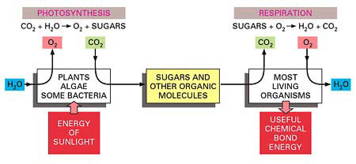
Compare - Contrast
LOOK

Slide 19
Get to the Point
Main Points:
1. Photosynthesis and Respiration are a cycle.
2. The purpose of the cycle is to turn light energy from the sun into chemical energy that living organisms can use!!!!

Slide 20
Photosynthesis and Respiration
 | Photosynthesis | Respiration
Function | Energy Capture | Energy Release
Location | Chloroplasts | Mitochondria
Reactants | CO₂ and H₂O and light energy | C₆H₁₂O ₆ (glucose) and O₂
Products | C₆H₁₂O ₆ (glucose) and O₂ | CO₂ and H₂O and energy (ATP)
Photosynthesis: 6CO₂ + 6H₂O + energy → C₆H₁₂O ₆ (glucose) + 6O₂
Respiration: C₆H₁₂O ₆ (glucose) + 6O₂ → 6CO₂ + 6H₂O + energy

