Slide 1
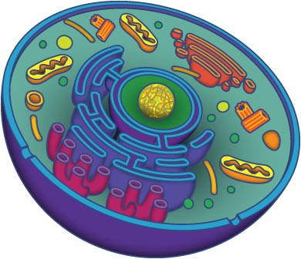
Cells

Slide 2
Some Important Terms
Prokaryotic cell: cell that does not contain a nucleus or any other membrane bound organelles
Bacteria
Eukaryotic cell: cell that does contain a nucleus and membrane bound organelles
Plant cells
Animal cells
Organelle: specialized structures found in cells that perform a variety of jobs
“Little organs” of cells
Cytoplasm: fluid portion of the cell

Slide 3
The “Dudes”
Robert Hooke
Discovered the cell
Robert Brown
Discovered the nucleus
Schleiden and Schwann
Cell theory
Edmund B Wilson
Studied cell division and heredity
Henri Dutrechet
The functioning of an organism depends on its cells

Slide 4
The Cell Theory
3 parts to the Cell Theory:
All living things are composed of cells.
Cells are the basic units of structure and function.
New cells are produced from existing cells.

Slide 6
Cell Organelles
Crash Course: Animal Cells - https://www.youtube.com/watch?v=cj8dDTHGJBY
Crash Course: Plant Cells -
https://www.youtube.com/watch?v=9UvlqAVCoqY

Slide 8
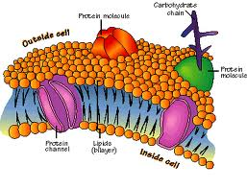
Cell Membrane
Regulates what enters and leaves the cell
Protection
Support
Found in both plants and animals

Slide 10
Nucleus
Structures:
Nuclear envelope: separates nucleus from rest of cell
Nucleolus: ribosomes are assembled here
Nuclear pores: allows materials to enter and leave nucleus
Chromatin: contains DNA and proteins
Control center of the cell (the “brain”)
Contains all DNA/RNA
Contains info needed to make proteins
Found only in eukaryotic cells

Slide 11
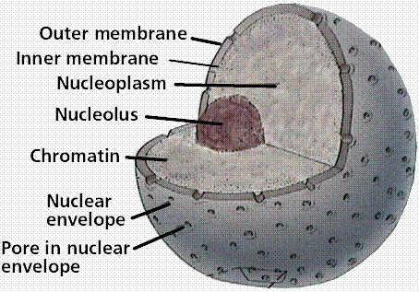
Nucleus

Slide 12
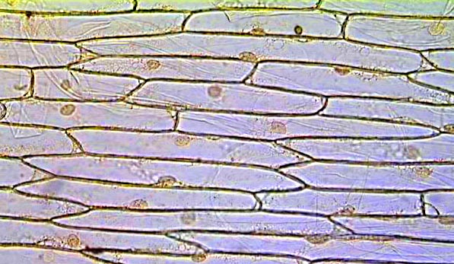
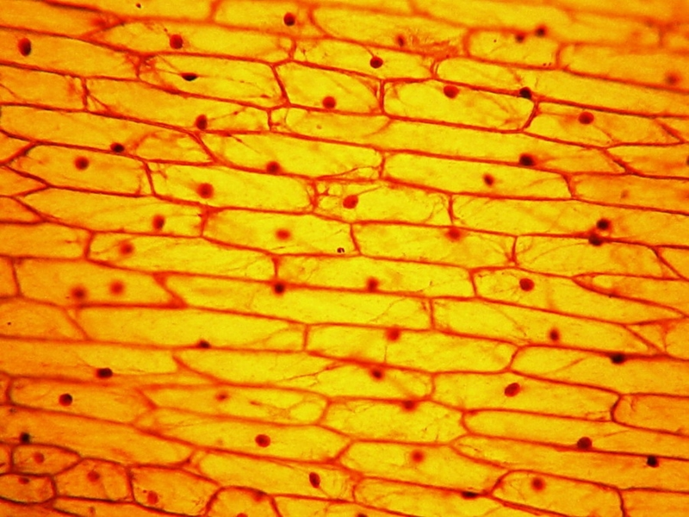
Nuclei in Onion Cells

Slide 13
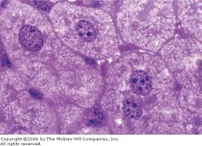
Nuclei in Liver Cells

Slide 14
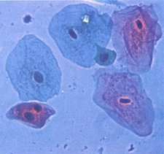
Human Cheek Cells

Slide 15
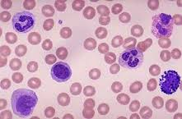
Only Animal Cell to NOT Have a Nucleus?

Slide 16
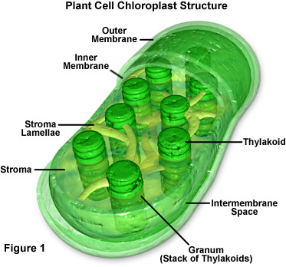
Chloroplast
Captures energy from sunlight and converts it into chemical energy → Photosynthesis
Found only in plants!

Slide 17
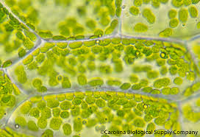
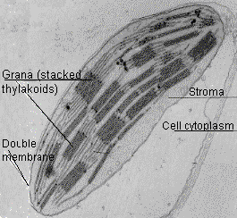
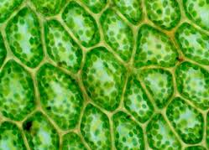
Chloroplasts

Slide 18
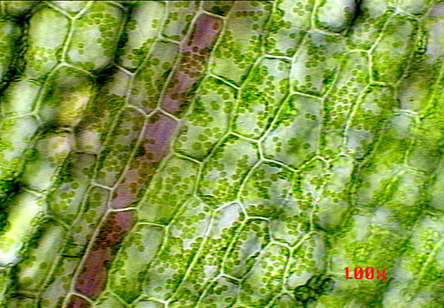
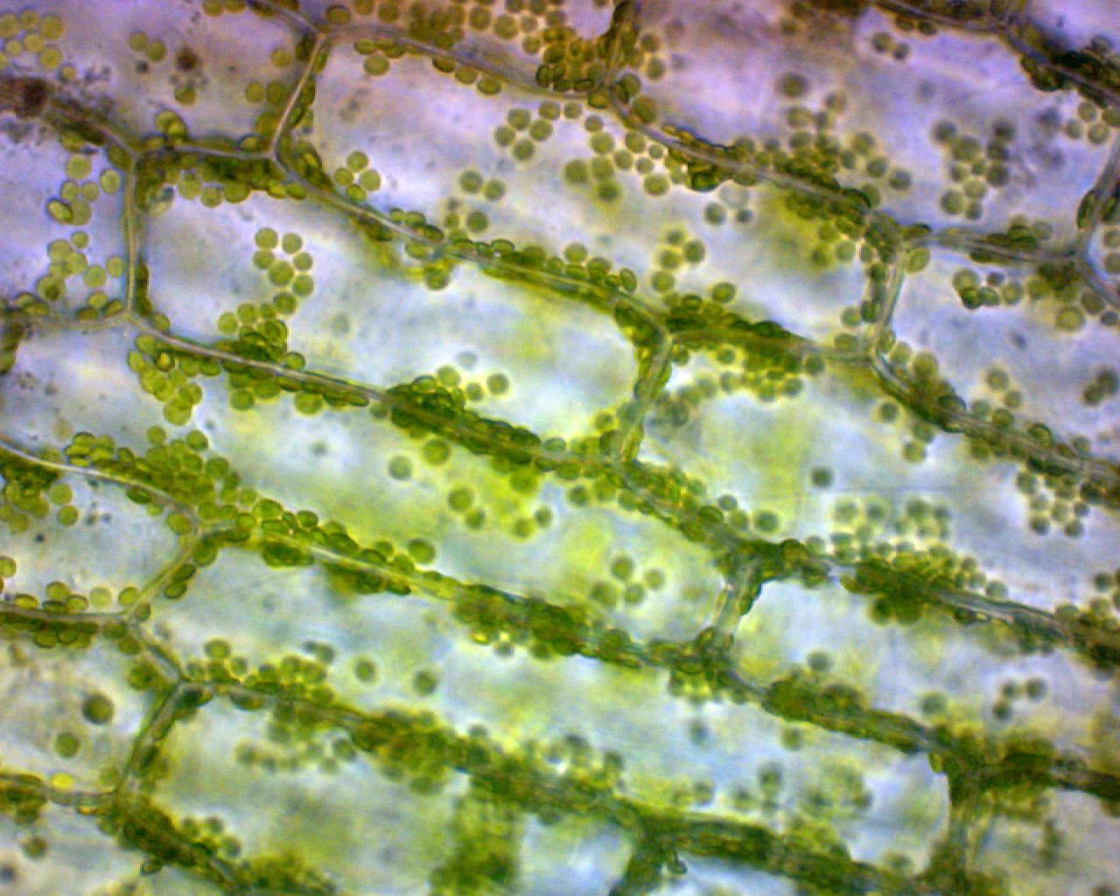
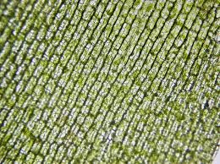
Elodea

Slide 19
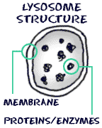
Lysosome
Filled with enzymes
Digests lipids, carbohydrates, and proteins into smaller molecules that the cell can use
Breaks down broken organelles
AKA… Junk collector, trash collector, garbage truck

Slide 20
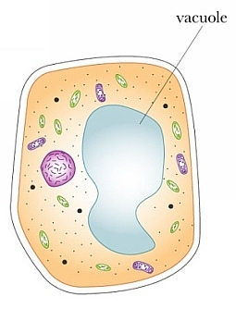
Vacuoles
Stores water, salt, proteins, and carbohydrates
Large in plants
Only some animals cells have one and they are small

Slide 21
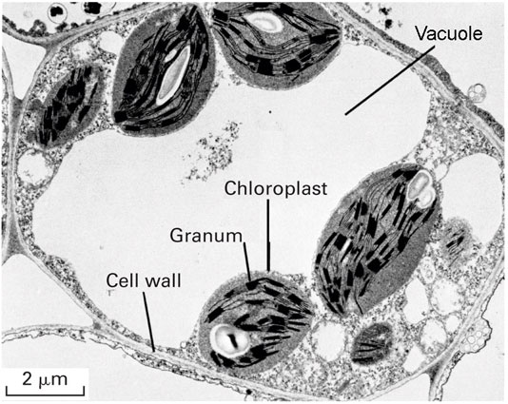
Vacuole

Slide 22
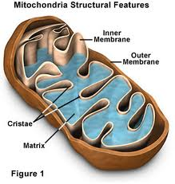
Mitochondria
Convert chemical energy stored in food into compounds that are more convenient for cells to use → called cell respiration
Makes ATP (energy molecule)
AKA… “Powerhouse”

Slide 23
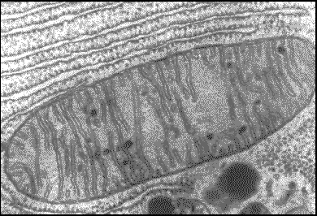
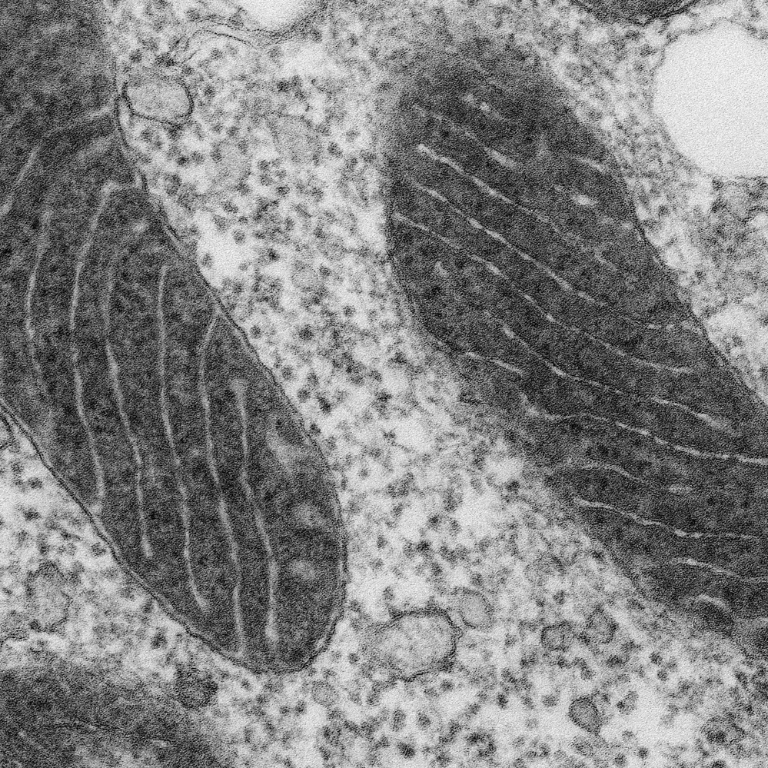
Mitochondria

Slide 24
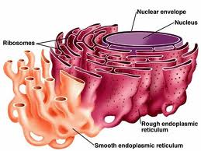
Endoplasmic Reticulum (ER)
Two types
Smooth ER: no ribosomes
Rough ER: covered in ribosomes
Assembles lipid components of membrane
AKA… “Assembly Line”
Eukaryotes only

Slide 25
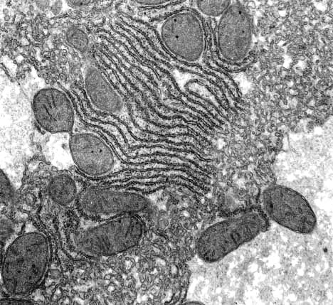
Endoplasmic Reticulum

Slide 26
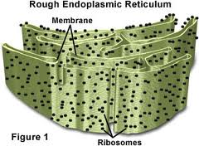
Ribosomes
Made of small particles of RNA
Assembles proteins (machine in the factory)

Slide 27
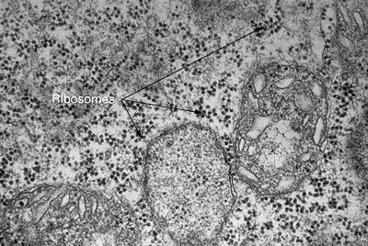
Ribosomes

Slide 28
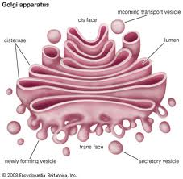
Golgi Apparatus (GA)
Modifies, sorts, and packages proteins and other materials from the ER for storage in the cell or secretion
Only found in eukaryotes
“Post Office”

Slide 29
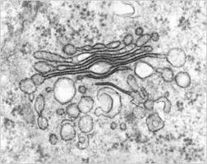
Golgi Apparatus

Slide 30
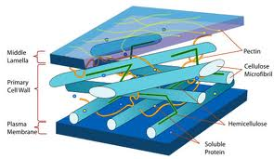
Cell Wall
Supports and protects plant cells
Found only in plant cells
Made of toughened fibers of cellulose

Slide 31
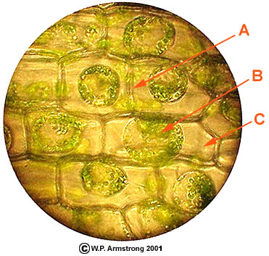
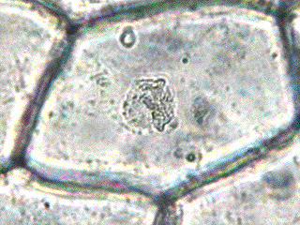
Cell Wall

Slide 32
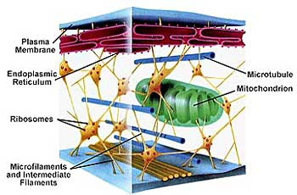
Cytoskeleton
Structures:
Microfilaments
Microtubules
Intermediate filaments
Helps cell maintain shape
Allows for movement of organelles throughout cell
Helps the cell move
Plays a role in chromosomes separating during cell division

Slide 33
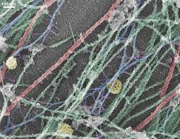
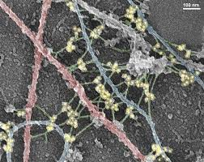
Cytoskeleton

Slide 34
Cilia and Flagella
Cilia – hair-like projections on the outside of a cell
Used for movement
Flagella – a “tail” used for movement

Slide 35
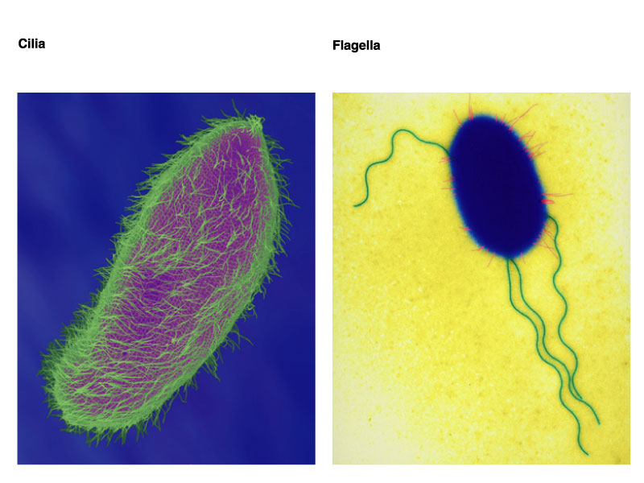

Slide 36
Cell Processes
Crash Course: Membranes and Transport - https://www.youtube.com/watch?v=dPKvHrD1eS4

Slide 37
More Important Terms
Active vs Passive Transport
Active requires energy
Passive requires NO energy
Concentration: the amount of solute in a solution
Shorthand = [ ]
Equilibrium: when the concentration is the same
When the solute is spread out evenly

Slide 38
Diffusion
Molecules move from an area of high [ ] to an area of low [ ] in order to reach equilibrium
Passive – NO energy required

Slide 39
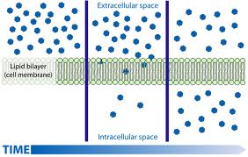
Diffusion

Slide 40
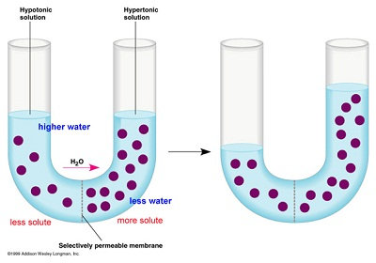
Osmosis
Diffusion of water through a semipermeable membrane
Semipermeable: only some stuff can move through it
High [water] to low [water]
Water moves from an area of low [solute] to high [solute]
Goal is to reach equilibrium

Slide 41
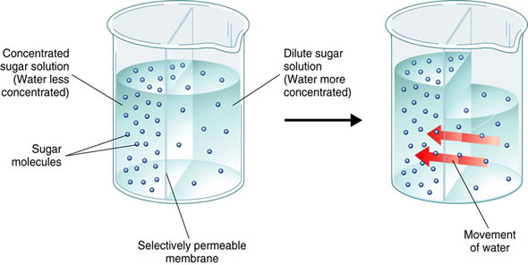
Osmosis

Slide 42
Osmosis
Hypertonic: solution has a higher [ ] than cell
hyper = higher
Water will move out of the cell → cell shrivels up and becomes dehydrated
Occurs when you drink salt water
HypOtonic: solution has a lower [ ] than cell
Hypo = low
Water will move into the cell → cell expands
“Thunder storms” in the produce section of a grocery store
Isotonic: the [ ] is the same inside and outside the cell
Equal movement into and out of cell

Slide 43
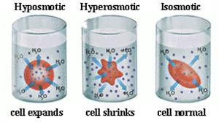
Osmosis

Slide 44
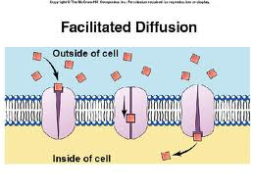
Facilitated Diffusion
Protein channels allow large molecules to pass through the membrane
Moves molecules from high [ ] to low [ ]
Every protein channel is specific

Slide 45
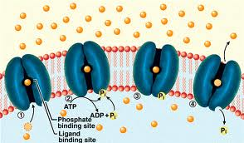
Protein Pumps
Movement of molecules against the [ ] gradient
Molecules move from low [ ] to high [ ]
Active transport = requires ATP (energy)

Slide 46
Endocytosis & Exocytosis
Endocytosis: taking materials into the cell by infolds of the membrane
Phagocytosis: bringing food into cell
Pinocytosis: bringing water into the cell
Exocytosis: materials exiting the cell
Type of active transport = requires ATP

Slide 47
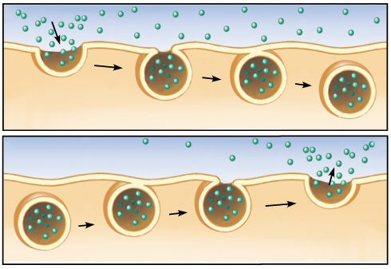
Endocytosis & Exocytosis

Slide 48
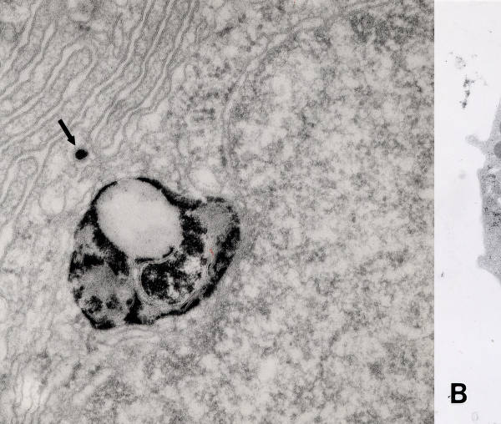
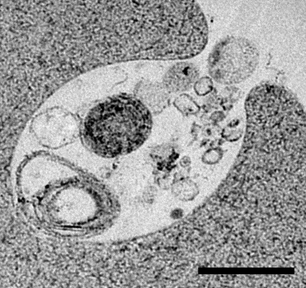
Endocytosis

