Slide 1
Cell Lab

Slide 2
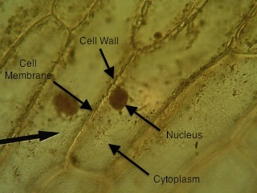
Onion cells

Slide 3
Elodea cell

Slide 4
Cheek Cell

Slide 5
Blood cells

